Slide 1
What movie do you want to watch next?
Note: this yellow box format indicates working notes for the team to serve as reminders
predicting movie success using Movies MARK®

Slide 2

Everyone loves movies.
Streaming has reshaped cinema and the COVID-19 pandemic has left many of us wondering “what should we watch next?”
Using data-wrangling, programming, and machine learning skills, we plan to answer:
What makes movies successful?

Slide 3


Our MARK Team
of budding Data Scientists collaborated virtually across Zoom and Slack (as “the_clever_crew”) to bring you this fine work.
Maggie Allen Presentation + GitHub + Dashboard
Andrew Malony GitHub + Graphs + Dashboard
Rose Baumann Database + Data Clean-up
Kathy Morrissey Data Clean-up + Machine Learning Model

Slide 4
But first we must ask
How do we define Movie Success?

Slide 5

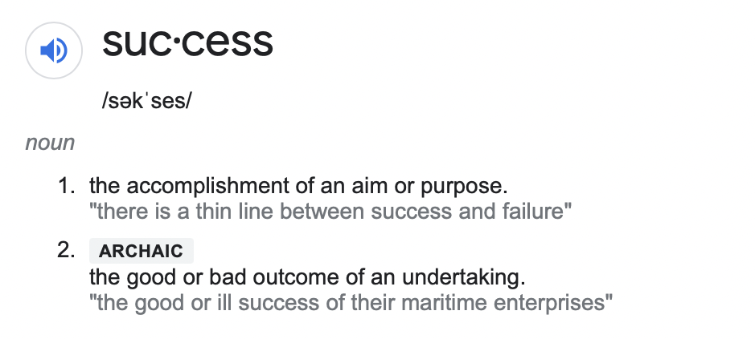
The Google Translate app can repeat anything you say in up to NINETY LANGUAGES from German and Japanese to Czech and Zulu

Slide 6
The Google Translate app can repeat anything you say in up to NINETY LANGUAGES from German and Japanese to Czech and Zulu
Popularity (Proprietary ratings, User Ratings)
Estimated Profitability (Revenue-Budget)
Awards
sadfasdfa

Slide 7

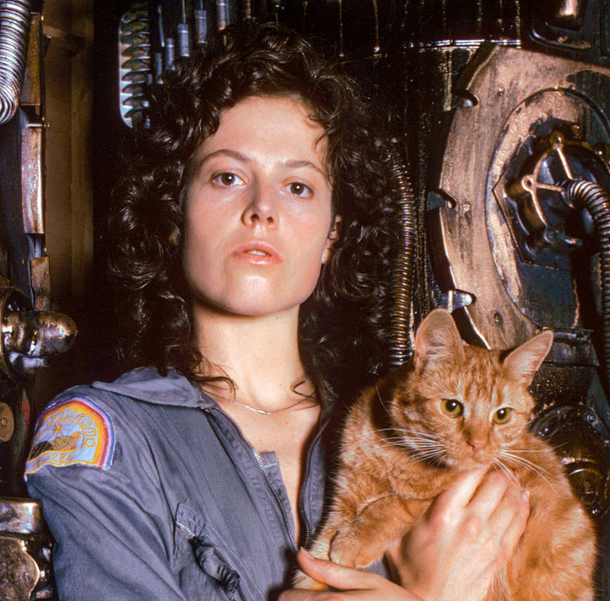
Meet Ellen.
She is the owner of a new start up streaming service, Serenity Streaming. She’s looking to use AI and Machine Learning to help connect users with their favorite movie they have never even heard of.
Right now she’s still working out of her home office and realizes despite a ton of data, she needs a proof of concept machine learning model to get investment interest.

Slide 8

Meet Sam.
Sam is a newly promoted executive at ABC Movie Productions and is interested in determining the right mix of movie genre, Director’s talents, and A-list actors are going to be the recipe for the next blockbuster.
Before him, the boomers were sitting in rooms making all the calls but he thinks data science can flip the script.

Slide 9
Meet Steel.
He recently had a baby so he has no time to watch a bunch of bad movies. When he finally has a free evening, he wants the first movie he streams to be one he’s happy to talk about with his new baby boy.
Let’s see what he should look for in his next popcorn night’s entertainment...

Slide 10

Whatever our solution will suggest, we should summarize here.

Slide 11


Internet Movies DataBase (IMDb)
The Movies DataBase (TMDB)
Kaggle Movies DataSet (not used)
WikiPedia (not used)
Worldwide
Directors
Our Data Exploration
Actors
Genres
1970+
Budget
MetaScore
Revenue
User Ratings
Source: https://www.imdb.com
https://www.themoviedb.org/?language=en-US
https://www.kaggle.com/rounakbanik/the-movies-dataset
Critic Scores

Slide 12
Data >
AWS RD + S3 >
Postgres >
Jupyter Notebook >
Pandas >
55 Catigorical Variables
Our Data Exploration
13 Numerical Variables
2 Boolean Variables
+
70 Total Variables

Slide 13
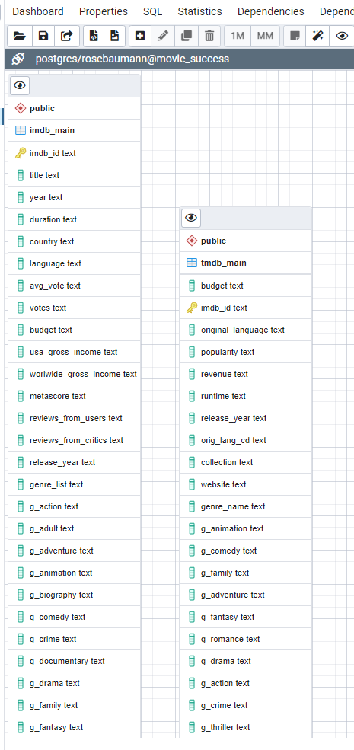
Technologies used
placeholder
Placeholder for Technologies, languages, tools, and algorithms used throughout the project

Slide 14

Our filtered data, once extracted and transformed went from
X number of entries or rows
Down to Y number of entities or rows

Slide 15
Add slide with missing data

Slide 16
:(
POPULARITY DATA
BUDGET/REVENUE DATA
AWARDS DATA
:(
Is it a coincidence that our instructor is the only happy camper in the bunch? Maybe...
:)

Slide 17
Data Model Stuff
Need to add our three - four models in a visual way so we can speak to these. May need bullets from Kathy.
Movies MARK®

Slide 18
Placeholder for Dashboard Slides + Interactive Graphs

Slide 19
Clever saying to finish us off on a note with a touch of humor..
Some sort of summary bullet of interest.

Slide 20
Where do we go from here?
Seek Out Additional Data Sources
Natural Language Processing
Deep Dive Categorical Variables
Predicting Future Success

Slide 21
Thank you.

Slide 22
APPENDIX

Slide 23
Link to Repository
Link to ReadMe.md file
Link to Profile Report

Slide 24
Pretty Graphs
October 2020
October 2021
August 2021
November 2021
A trigger to kick us off
Timing of an event
2020 |  |  |  | 2021
Something interesting
Moment of consideration

Slide 25

Then, Steel discovered Movies MARK®
Now he can use our simple list of factors to determine if this is a movie he would be happy to watch..

